Slide 1
IBM University Engagement Project Submission
“Exploring the Power of Agentic AI with IBM Granite and IBM Bob”

Slide 2

Project Tile – ResearchMind AI – An Agentic AI Research Companion for Intelligent Literature Analysis and Research Discovery
Domain of Project – Education
Student Name | Recent Passport Photo | Email ID | Mobile number [WhatsApp]
Dr. Sukanta Kumar Das |  | Sukanta.d@srisriuniversity.edu.in | 9861383101

Slide 3
Problem Statement -
Problem Statement : ResearchMind AI – An Agentic AI Research Companion for Intelligent Literature Analysis and Research Discovery
The Challenge
Modern researchers, students, and innovators spend countless hours searching through academic papers, understanding complex research topics, identifying knowledge gaps, and predicting emerging trends. Traditional search engines retrieve documents but do not actively reason, collaborate, or generate research insights. Researchers must manually read numerous papers, compare findings, summarize literature, discover unexplored areas, and forecast future directions, making the research process slow and inefficient.
ResearchMind AI addresses this challenge by leveraging IBM watsonx.ai Studio and IBM Granite Foundation Models within an Agentic AI architecture where multiple intelligent agents collaborate to automate the research workflow.
The Objective
Demonstrate the use of IBM watsonx.ai Studio.
Utilize IBM Granite Foundation Models for reasoning and content generation.
Showcase an Agentic AI architecture with autonomous task planning.
Implement multi-agent collaboration for specialized research tasks.
Build a lightweight Retrieval-Augmented Generation (RAG) system without a database.
Automatically generate:
Literature reviews
Research summaries
Research gap analysis
Emerging trend forecasts
Deliver the complete solution as a single app.py Flask application without external databases or paid APIs.

Slide 4
Proposed Solution -
Proposed Solution : ResearchMind AI – Intelligent Research Companion
Overview
ResearchMind AI is an Agentic AI-powered research assistant designed to simplify and accelerate the research process using IBM watsonx.ai Studio, IBM Granite Foundation Models, and a lightweight Retrieval-Augmented Generation (RAG) system. Rather than functioning as a conventional chatbot, the application employs a team of specialized AI agents that collaborate autonomously to retrieve knowledge, analyze research content, generate literature reviews, identify research gaps, and forecast emerging trends.
The solution is implemented as a single-file Flask application (app.py) in Python without using databases or paid APIs, making it lightweight, portable, and easy to deploy.
How the Solution Works
Step 1 – User Input
Step 2 – Agent Planning
Step 3 – Knowledge Retrieval (Lightweight RAG)
Step 4 – Multi-Agent Collaboration
Step 5 – IBM Granite Reasoning
Step 6 – Report Generation

Slide 5
Technology Used
IBM watsonx Orchestrate (IBM watsonx Orchestrate / IBM BOB Platform) | Used to visually design and orchestrate the multi-agent workflow. It coordinates specialized agents (Retrieval Agent, Literature Review Agent, Research Gap Agent, Trend Forecasting Agent, and Report Generation Agent) to automate the end-to-end research process.
IBM Granite Model (e.g., ibm-granite-3-2-8b-instruct) | Serves as the core Large Language Model (LLM) for natural language understanding, reasoning, summarization, literature review generation, research gap identification, trend forecasting, and personalized research assistance.
IBM Cloud | Provides the secure, scalable, and reliable cloud infrastructure to develop, deploy, host, and scale the ResearchMind AI application and its AI services.
Retrieval-Augmented Generation (RAG) | Retrieves relevant research documents, papers, abstracts, and knowledge before invoking the Granite model. This grounds AI responses in factual context, improving the accuracy and trustworthiness of generated research insights.
IBM watsonx.ai Studio | Used for prompt engineering, Granite model deployment, inference APIs, embeddings, model management, and AI governance, enabling responsible and production-ready AI workflows.
Vector Database (FAISS or ChromaDB) | Stores vector embeddings of research papers, abstracts, and documents to enable semantic search and efficient retrieval for the RAG pipeline. It allows the system to find the most relevant research context based on meaning rather than exact keyword matches.
Python | Primary programming language used to implement the multi-agent architecture, RAG pipeline, and backend logic.
Flask | Lightweight web framework used to build the web interface, REST APIs, and integrate the frontend with IBM watsonx.ai services.

Slide 6
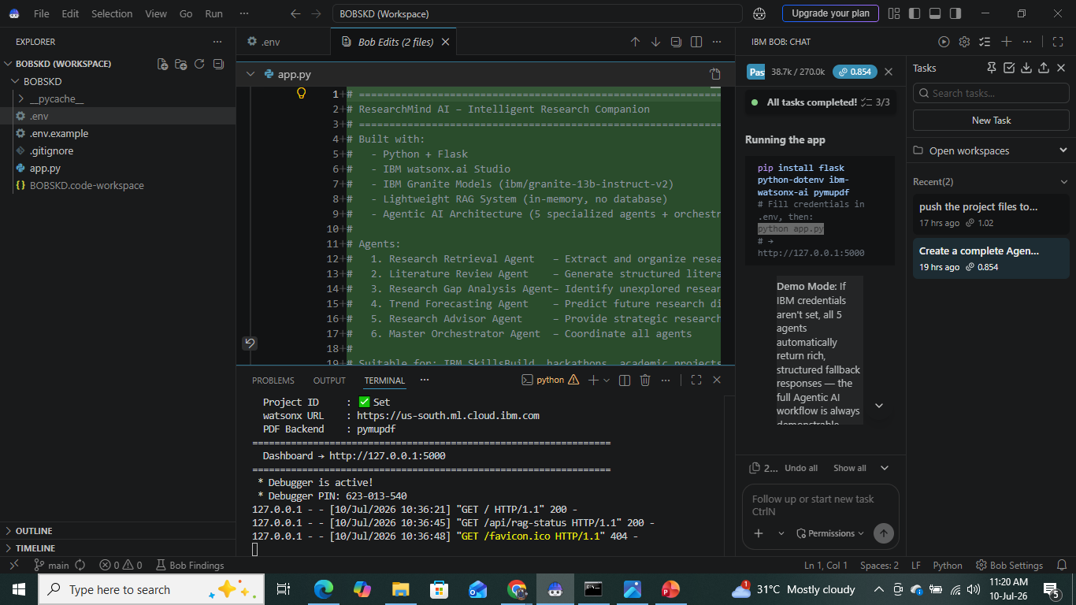
Required Files created using IBM bob -
_pycache_
.env
.env.example
.gitignore
App.py

Slide 7
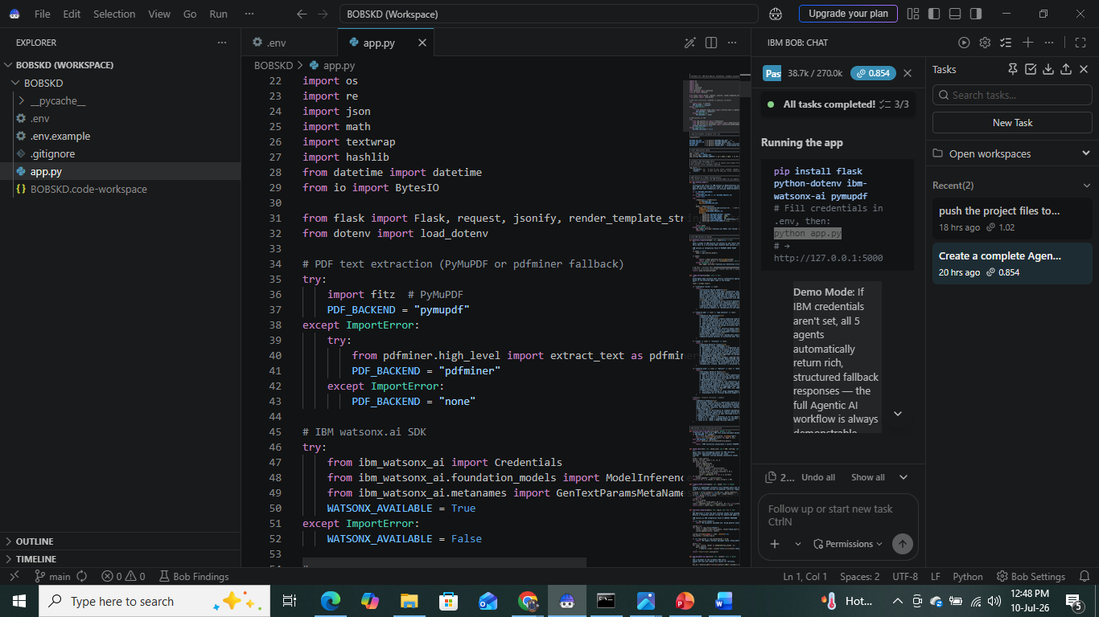
IBM Bob Screenshots:

Slide 8
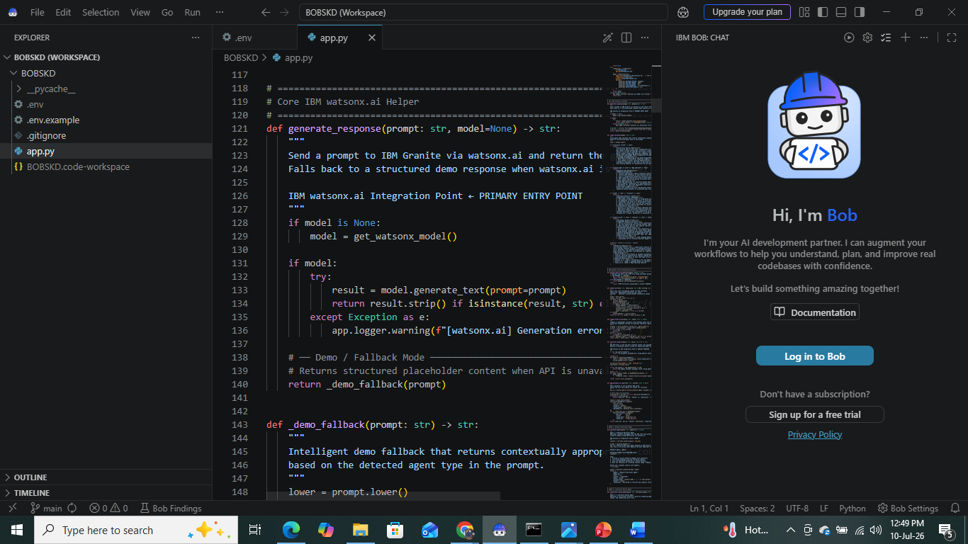

Slide 9
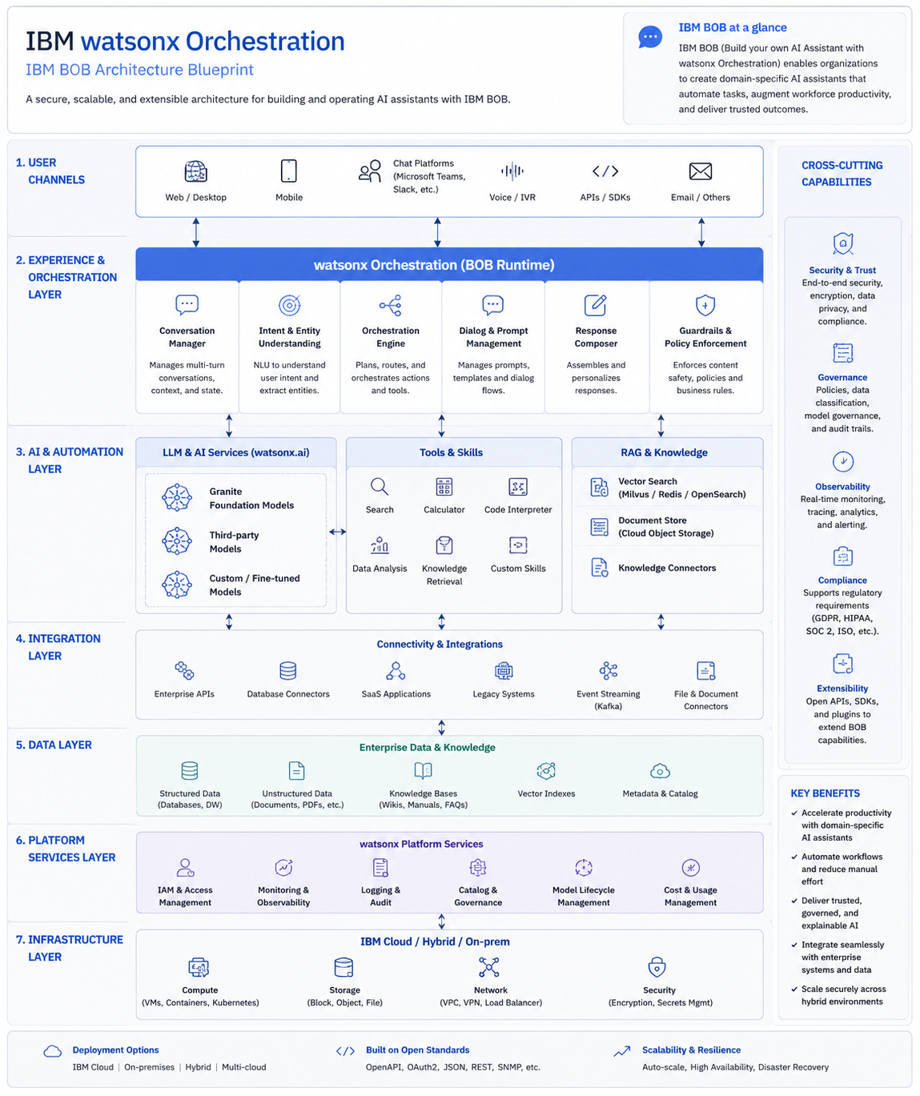
Architecture blueprint for IBM bob:

Slide 10

Role of Agentic AI in the solution
Role of Agentic AI in ResearchMind AI – Intelligent Research Companion
Overview
Agentic AI is the core intelligence behind ResearchMind AI. Rather than relying on a single AI model to answer research questions, the application employs a team of specialized AI agents powered by IBM Granite Models and coordinated through IBM watsonx.ai Studio. Each agent has a distinct responsibility and collaborates with the others to complete complex research tasks.
This mirrors the way a real research team works, where different experts contribute their knowledge to produce a comprehensive, evidence-based outcome.
In ResearchMind AI, Agentic AI transforms the application from a conventional chatbot into an intelligent research ecosystem. By orchestrating multiple IBM Granite-powered agents through IBM watsonx.ai Studio and combining their capabilities with a lightweight RAG pipeline, the system can retrieve research knowledge, synthesize literature, identify research gaps, forecast emerging trends, and generate actionable research plans. This collaborative, explainable, and modular architecture demonstrates how Agentic AI can support the complete research lifecycle, making the solution well suited for IBM SkillsBuild, hackathons, academic projects, and AI showcases.

Slide 11
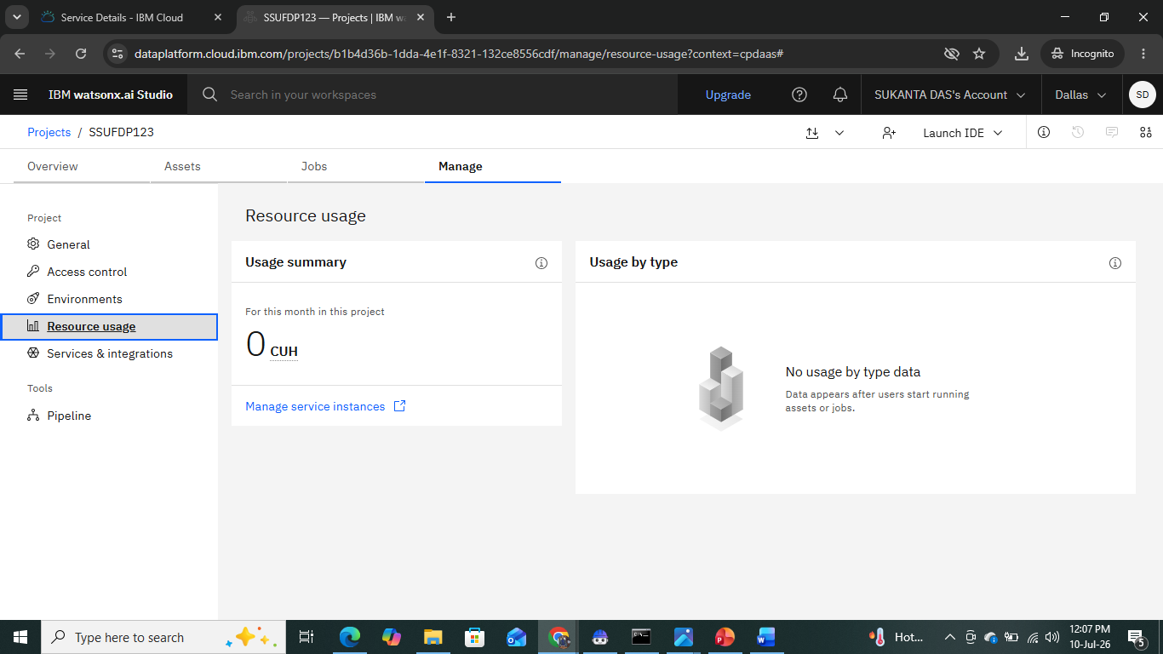
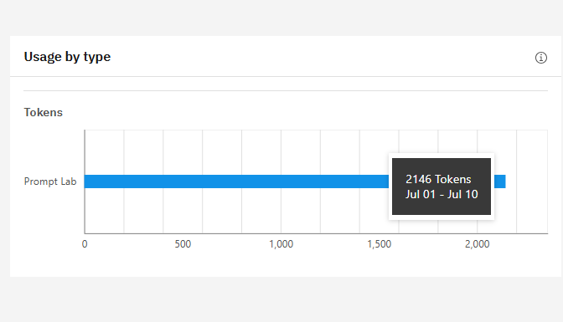
Token Usage
2146 token are used
Before Prompt
After the Prompt
·
·
·

Slide 12
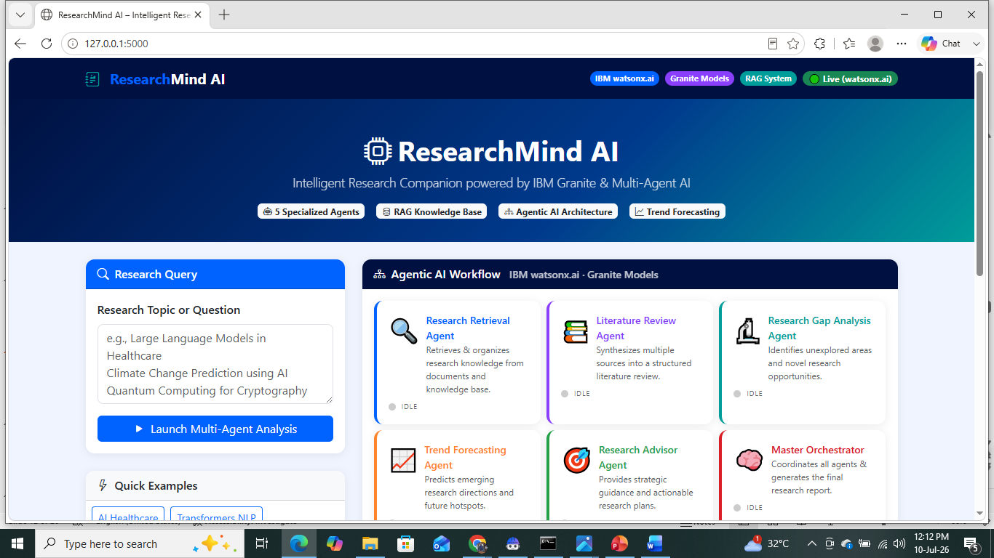
Project Output Screenshot
·
·
·

Slide 13
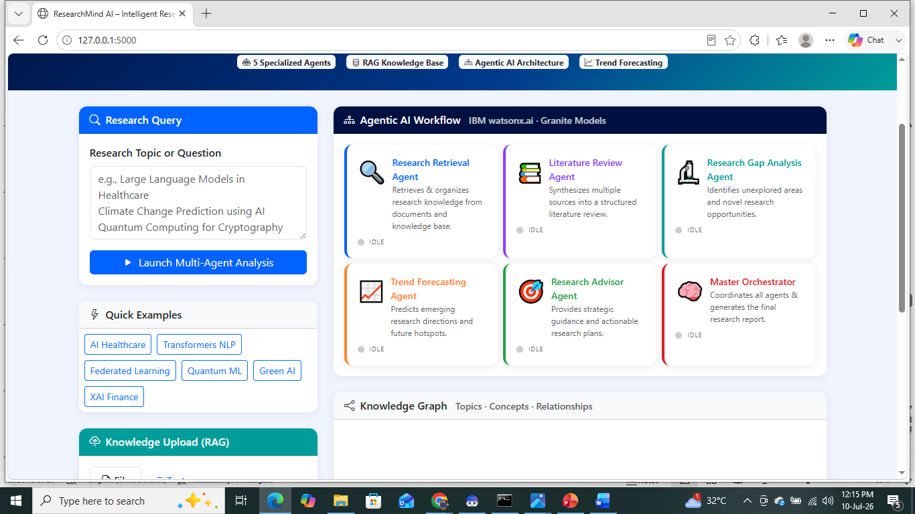
Project Output Screenshot
·
·
·

Slide 14
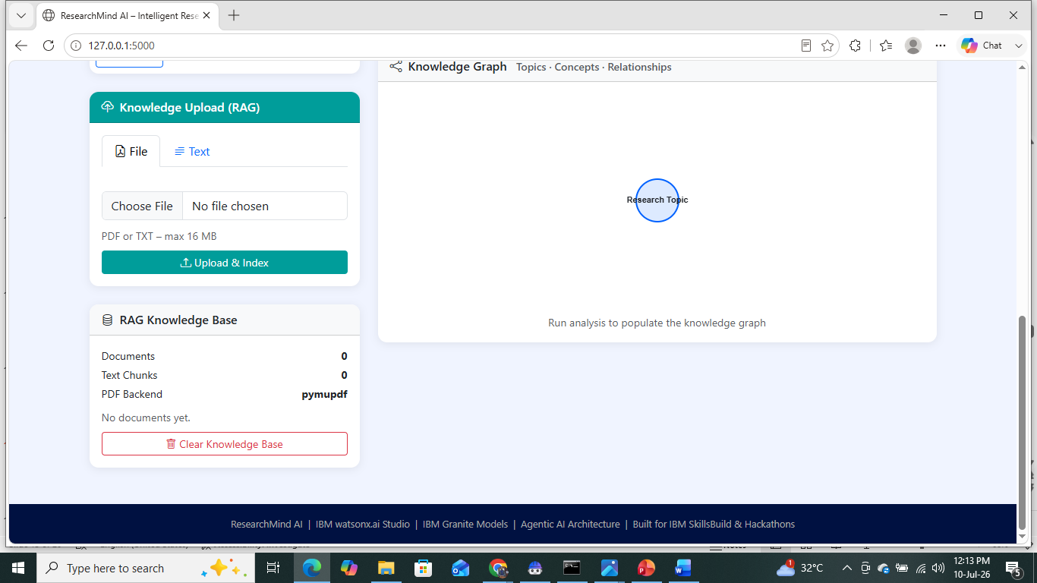
Project Output Screenshot
·
·
·

Slide 15
Novelty and Uniqueness
Novelty & Uniqueness of ResearchMind AI
The main novelty is not simply using IBM Granite or RAG. The innovation comes from an Agentic AI architecture where multiple specialized Granite-powered agents collaborate under an orchestrator to perform an end-to-end research workflow.
1. Agentic AI Research Team (Core Innovation)
2. Multi-Agent Collaboration
3. IBM Granite-Powered Scientific Reasoning
4. Agentic RAG (Beyond Traditional RAG)
5. Autonomous Research Planning
6. Explainable Agent Workflow
7. Research Knowledge Graph
8. Automatic Research Gap Discovery
9. Trend Forecasting Agent
10. Intelligent Research Advisor

Slide 16
Git Hub Link
Please test and Paste the working Github URL –
https://github.com/skdas-it/SSU-FDP.git
·
·
·

Slide 17
Future Scope
Future Scope of ResearchMind AI – Intelligent Research Companion
ResearchMind
AI is designed as a foundation for an advanced Agentic AI-powered research ecosystem. While the initial implementation demonstrates IBM Granite Models, IBM watsonx.ai Studio, multi-agent collaboration, and a lightweight RAG system, there are numerous opportunities for future enhancements.
1. Autonomous Research Agents
2. Integration with Academic Research Databases
3. Advanced RAG Architecture
4. Graph-Based Research Intelligence
5. AI-Powered Citation Intelligence
6. Multi-Modal Research Understanding
7. Scientific Experiment Planning
·
·
·

Slide 18
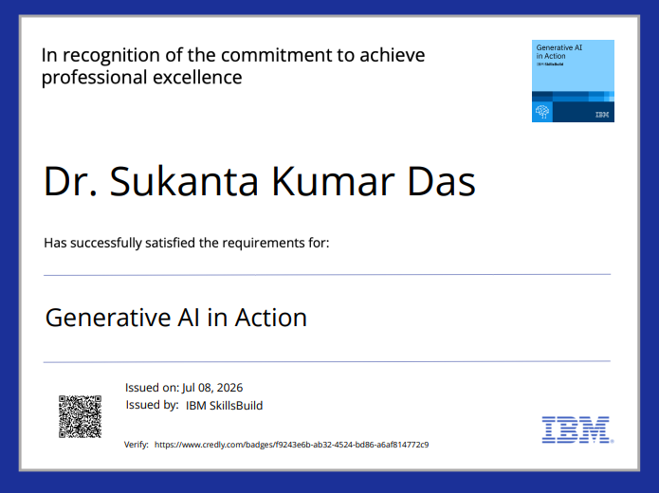
Certificates Earned:

Slide 19
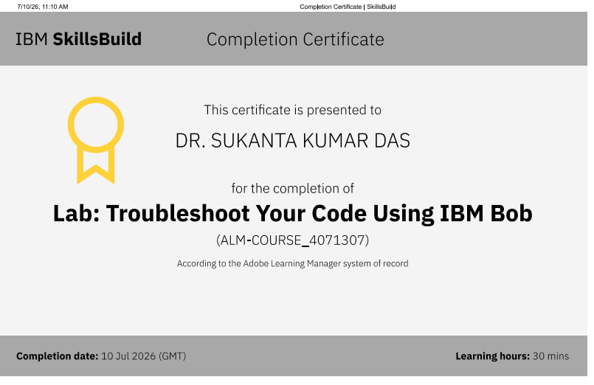
Certificates Earned:​

Slide 20


